Slide 1

WileyPLUS
First Day of Class
wileyplus.com

Slide 2
Today’s Agenda
Register in minutes
Purchase options
eBook and Resources
Get help if you need it

Slide 3
Register in Minutes

Slide 4
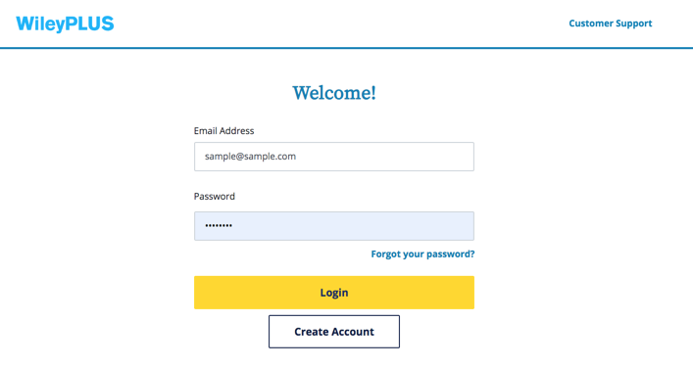
Go to: www.wileyplus.com/go/login
Register - In Minutes!
If you have a WileyPLUS account already, log in. If this is your first time using WileyPLUS, please click Create Account

Slide 5
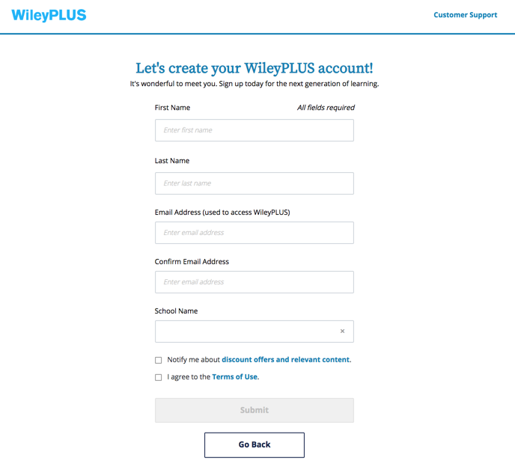
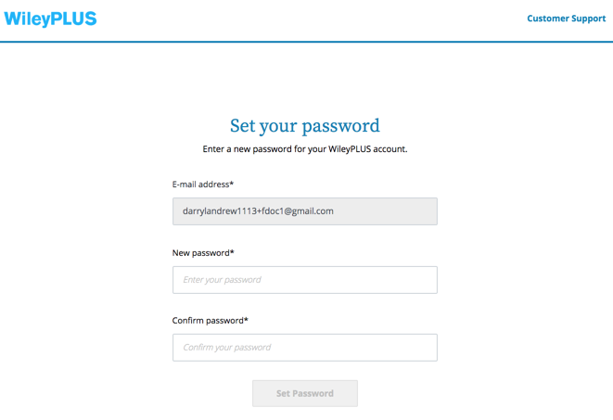
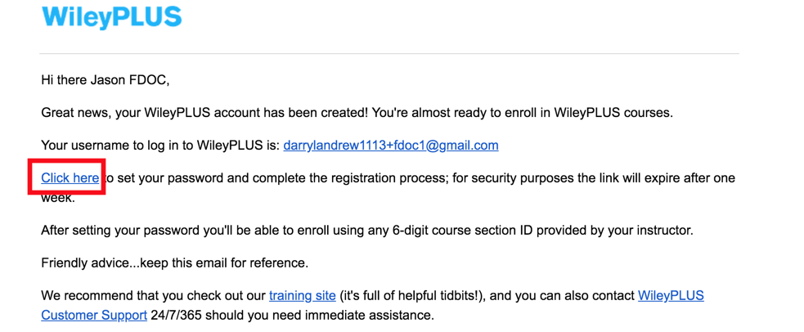
New Users
Register - In Minutes!
Complete account setup form and click submit. Check your email for a link to create your password.

Slide 6
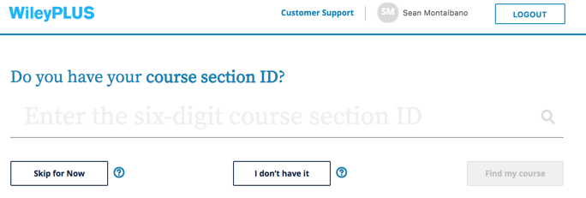
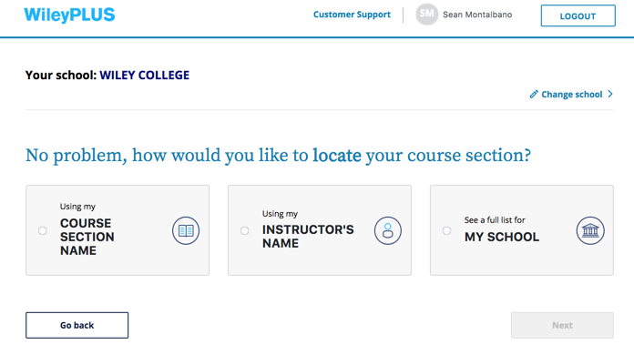
Course ID
Register - In Minutes!
If your instructor has provided you with a WileyPLUS Course ID, enter it into the space provided.
Don’t Have the Course ID?
Click “I don’t have it” to search by Course Section Name, Instructor Name, or Courses offered at your school

Slide 7
Purchase Options – Two Places to Buy
Direct from Your Bookstore
-or-
Direct Online From Your WileyPLUS Course

Slide 8
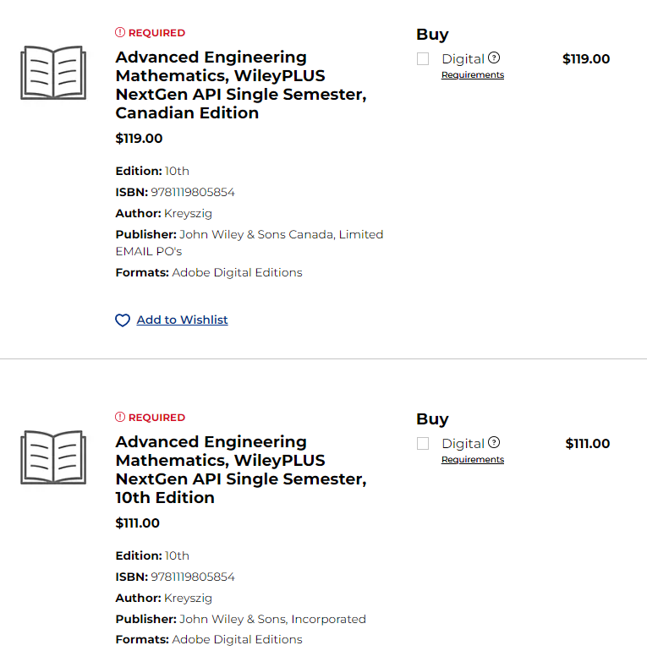
Bookstore
**Both bookstore options are the same**
*Please note: WileyPLUS comes with a built in, downloadable e-text for the duration of the term
1
2

Slide 9
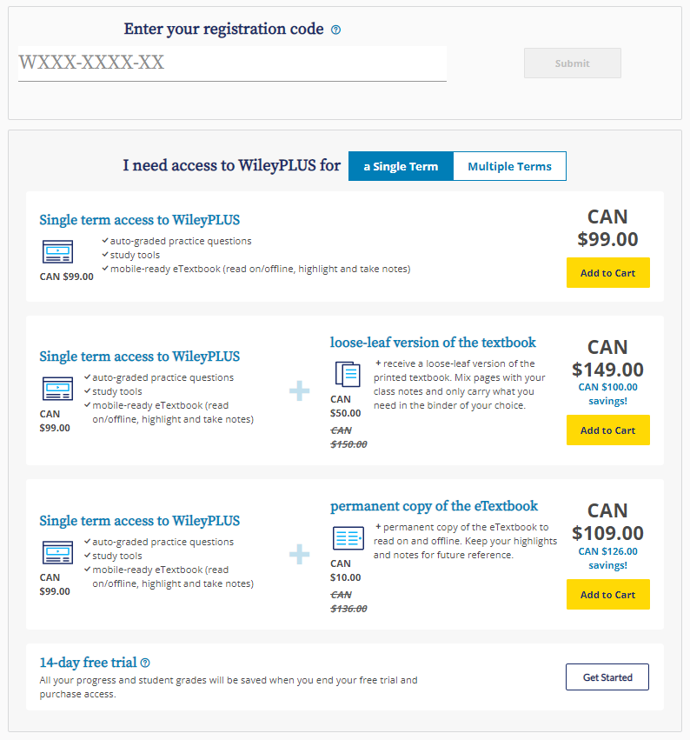
Buying Options
Enter in Registration code from a bookstore purchase
Choose your Access length *Option varies per title
Purchase only WileyPLUS (includes full eText access for the length of the term)
Purchase WileyPLUS + Printed Loose-leaf Text
Purchase WileyPLUS + Permanent copy of eText
Register for 14-day Free Trial
* Pricing may vary by title and access length
1
2
3
4
5
6

Slide 10
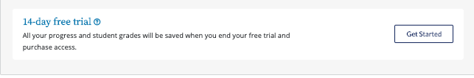
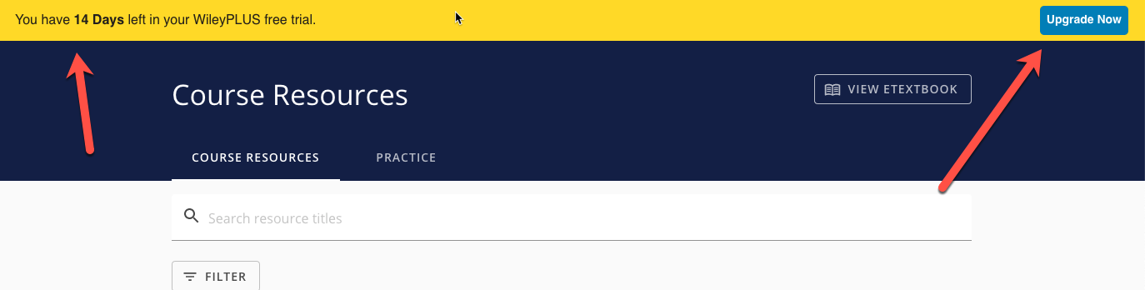
14-day Free Trial
Buy Direct - Save Money!
Need more time deciding which option is best for you?
Select the 14-day Free Trial and access WileyPLUS today.
Throughout your Free Trial you will see a countdown and option to upgrade your access. This will disappear after your trial has ended or you make a purchase

Slide 11
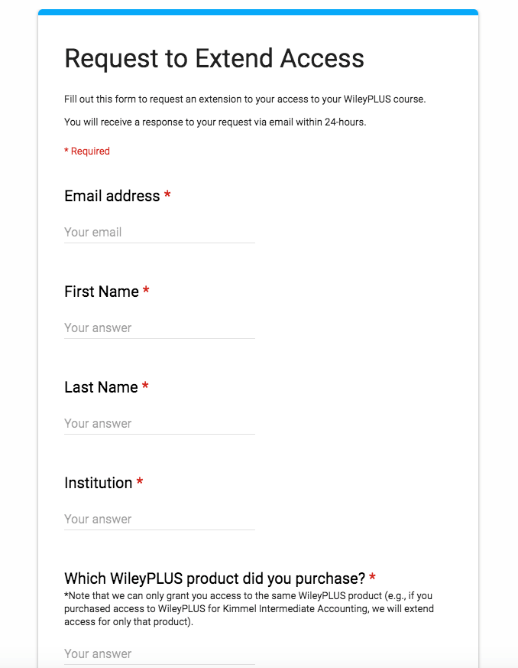
Are You Re-Taking this course again?
Buy Direct - Save Money!
Need to retake the course again, and already purchased WileyPLUS in the previous semester?
Do not worry about having to rebuy WileyPLUS access again. Simply complete our Extended Access form for the new semester.
Here are the steps to get Extended Access:
Log into WileyPLUS with the same account
Access via the 14 Day Free Trial
Go to https://www.wileyplus.com/wp-access/ and complete the form

Slide 12
eBook and Resources

Slide 13
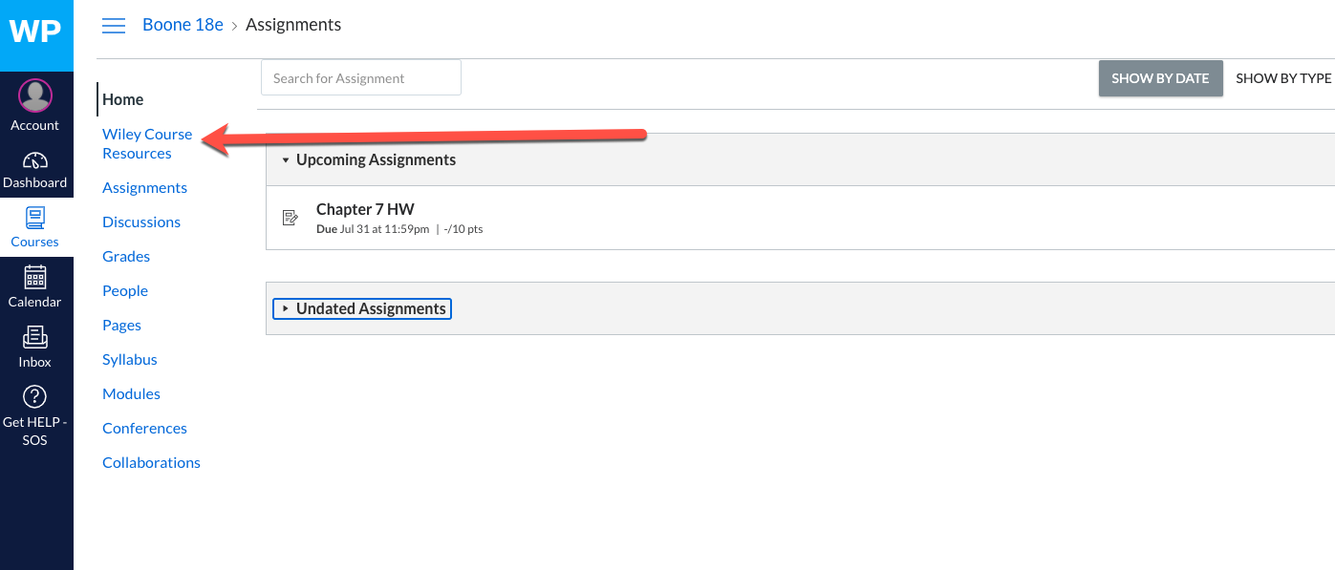
Access your Course Content
Learn How - Get the Grade!

Slide 14
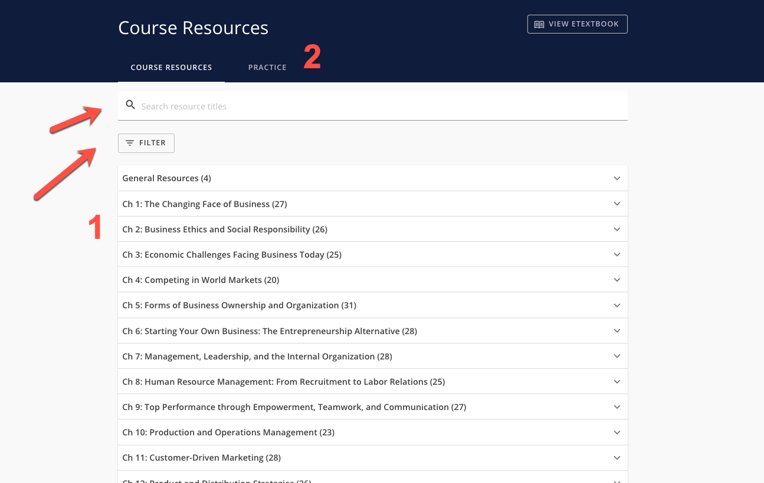
Course Resources
Learn How - Get the Grade!
From your Course Resources, you will have access to all of the content in your course. From here you can easily filter for specific resources, or:
Click a chapter to expand all of the content available
Looking for additional practice questions? Click Practice to help prepare

Slide 15
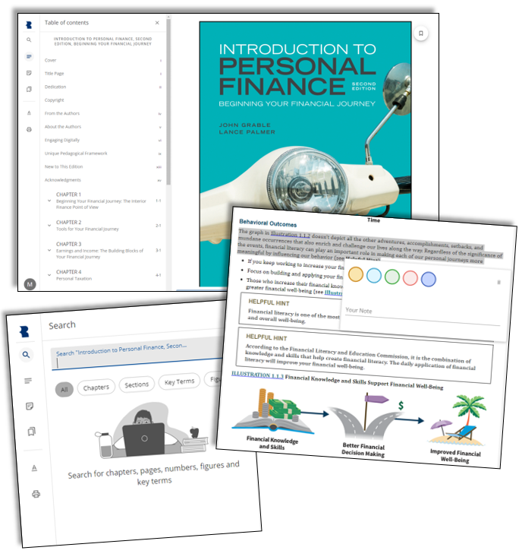
eText
Learn How - Get the Grade!
In the eText you will have:
Full searchability
Highlight and Note Taking abilities
Read aloud features
Customized display settings

Slide 16
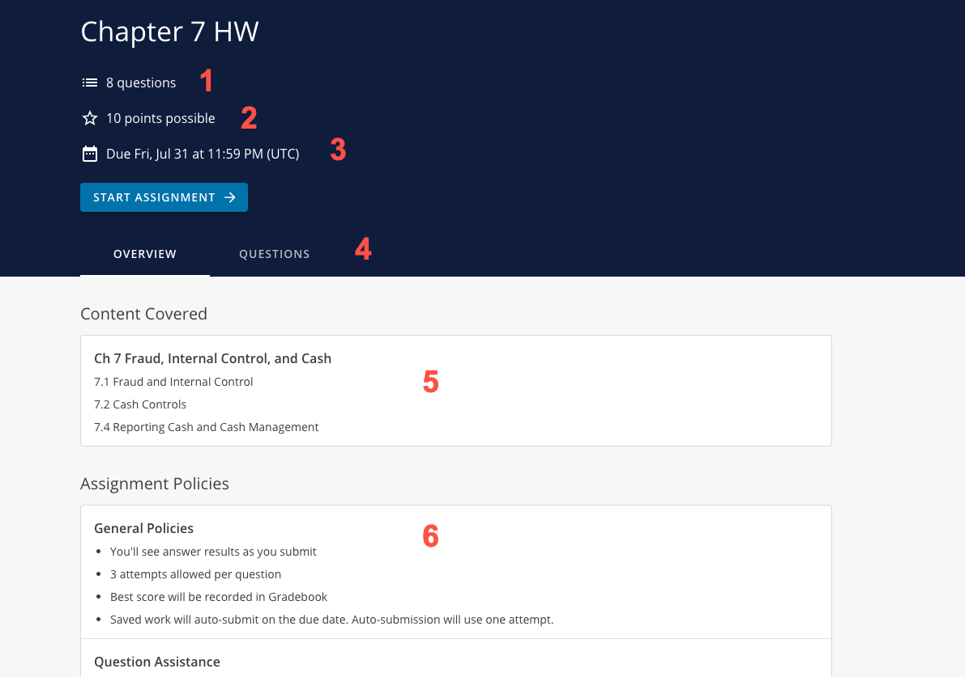
Assignments
Learn How - Get the Grade!
When attempting your assignments, you will start from your Assignment Overview page. Here you will see:
How many questions are on your assignments
Total Points available
Due Date
Access to review questions
Content covered *Determined by instructor
Assignment Policies

Slide 17
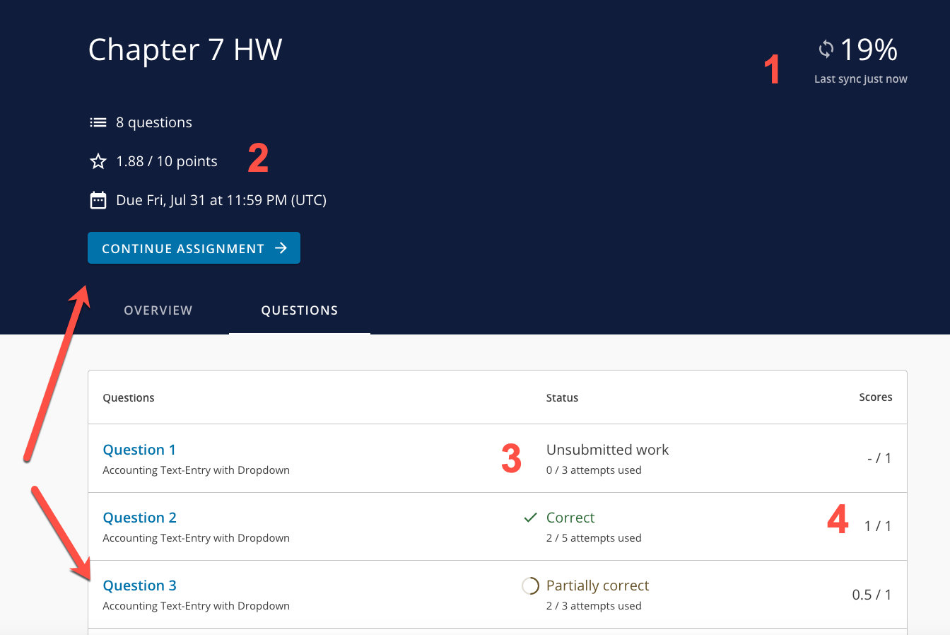
Reviewing your Work
Learn How - Get the Grade!
After you have attempted your assignment, when reviewing your Assignment Overview page you will see:
Your assignment percentage score and a refresh icon (incase you notice a grade discrepancy)
Your gradebook score
Your status on each question and attempts used
Question score
If you still have attempts left before the due date, you can either click Continue Assignment or click on the question you would like to attempt.

Slide 18
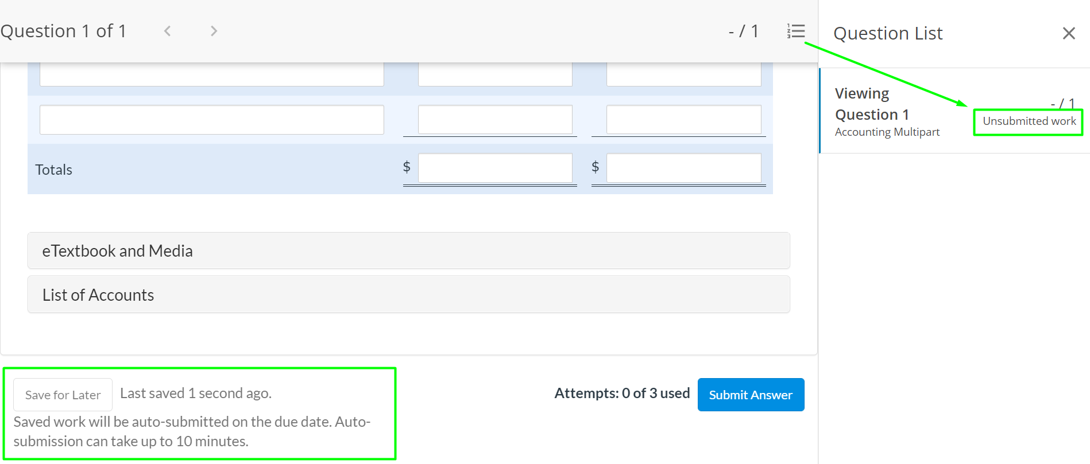
Assignment Best Practices
Learn How - Get the Grade!
Only use Chrome or FireFox.
Use the “Submit Answer” button to submit all work before the due date.

Slide 19
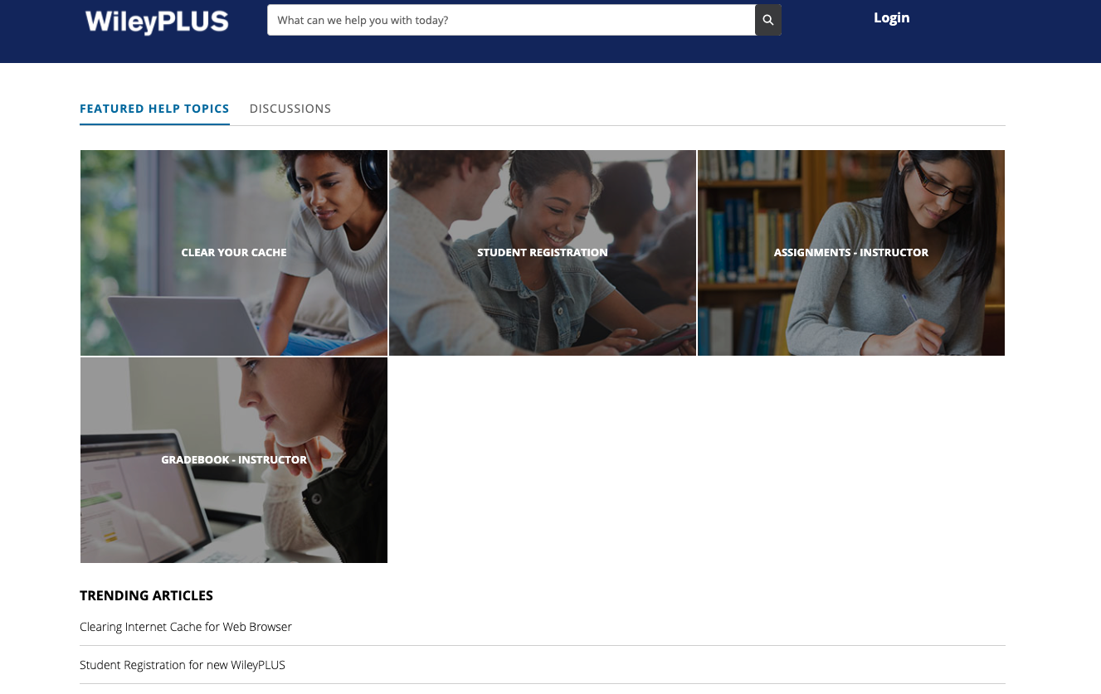
Technical Support - 24/7
Get Help - If You Need It!
At https://wpsupport.wiley.com/s/, you can search FAQs, view trending topics, and chat with a WileyPLUS expert

Slide 20

WileyPLUS
Good luck in your course!
wileyplus.com
Notes:
This deck uses Source Serif Pro and Open Sans fonts exclusively. Please have these fonts installed on the machine displaying your presentation to guarantee text displays correctly. To represent a cohesive color theme, this sample presentation is sectioned into three color themes—Dark Blue, Light Blue, and White. Use this as a guideline to keep the content of your presentation organized.

